Slide 1
Image Enhancement

Slide 2
Arithmetic operations
Arithmetic operations between images are array operations. The four arithmetic operations are denoted as
s(x,y) = f(x,y) + g(x,y)
d(x,y) = f(x,y) – g(x,y)
p(x,y) = f(x,y) × g(x,y)
v(x,y) = f(x,y) ÷ g(x,y)

Slide 3



Image addition
a
b
a+b

Slide 4
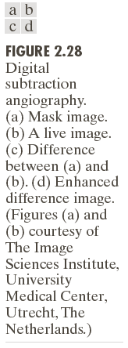
Image subtraction

Slide 5
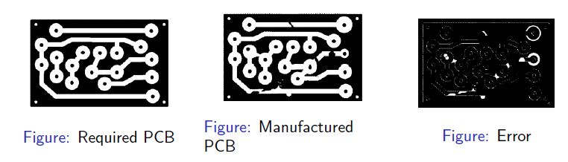
Highlight the manufacturing defects in an industry.
MATLAB: imsubtract

Slide 6
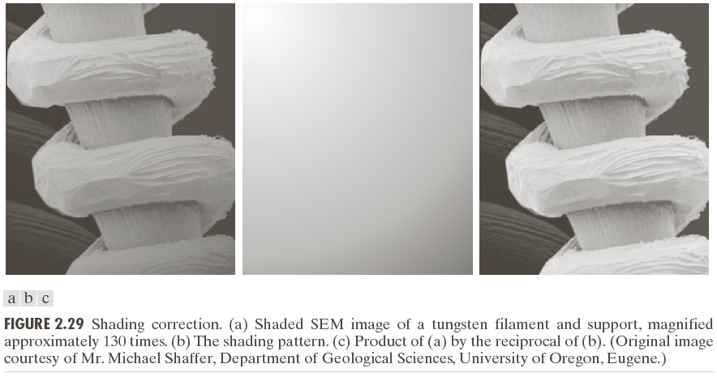
Image Multiplication
W=immultiply(X,Y)

Slide 7
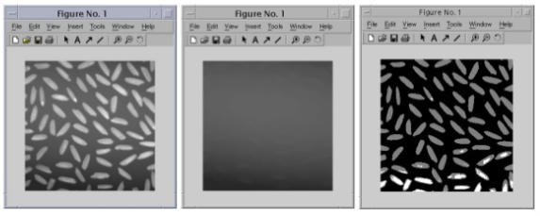
Image Division
W=imdivide(X,Y)

Slide 8
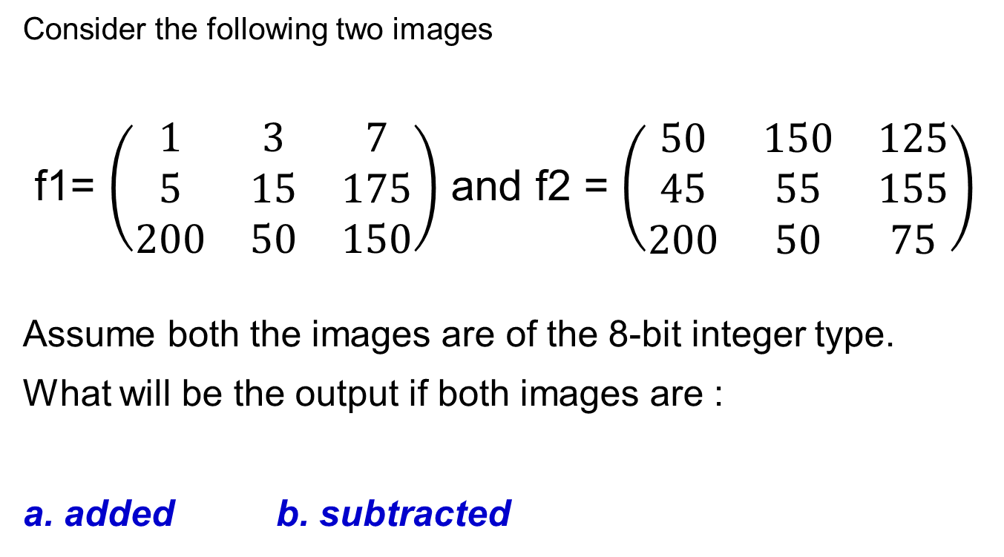
Q1.
Consider the following two images
f1= $\left(\begin{matrix}1 & 3 & 7 \\ 5 & 15 & 175 \\ 200 & 50 & 150\end{matrix}\right)$ and f2 = $\left(\begin{matrix}50 & 150 & 125 \\ 45 & 55 & 155 \\ 200 & 50 & 75\end{matrix}\right)$
Assume both the images are of the 8-bit integer type.
What will be the output if both images are :
a. added b. subtracted

Slide 9
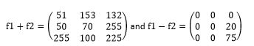

Slide 10
Logical operations in an image

Slide 11
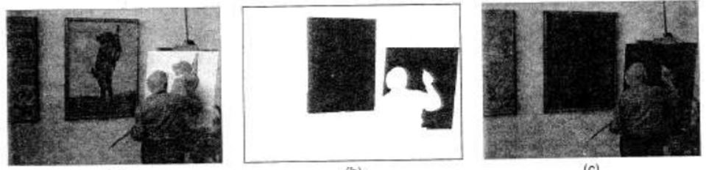
AND operation
The AND operator is usually used to mask a part of an image.

Slide 12
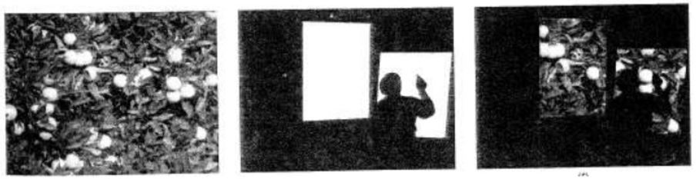
OR operator
Part of another image can be added with the second image

Slide 13
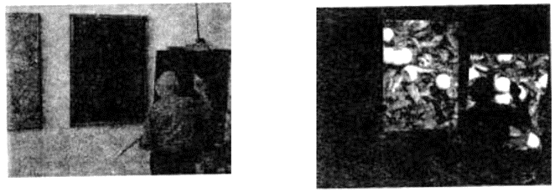
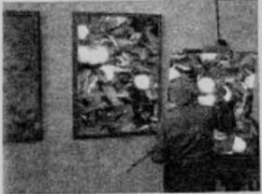
cont…

Slide 14
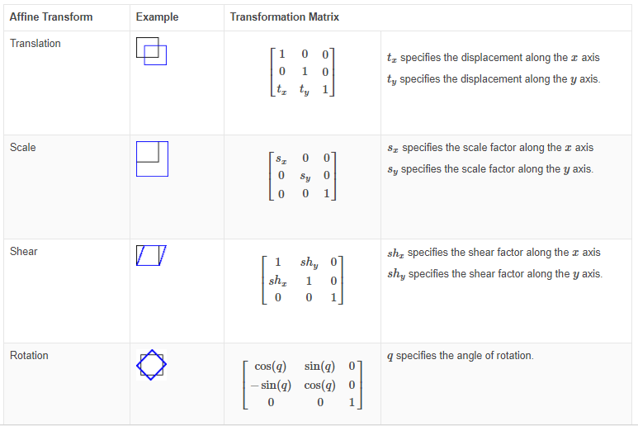
Affine transformations in an image

Slide 15
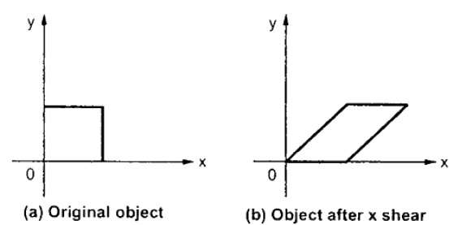
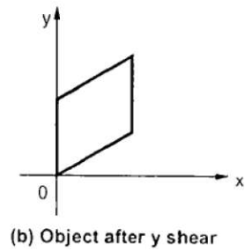
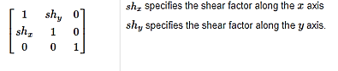
Affine transform- Shear
(c)

Slide 16
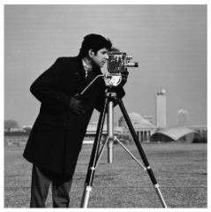
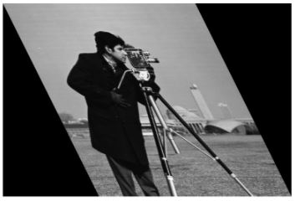
eg. Horizontal shear
I = imread('cameraman.tif');
tform = maketform (‘affine’,[1 0 0; 0.5 1 0; 0 0 1])
J = imtransform(I,tform);

Slide 17
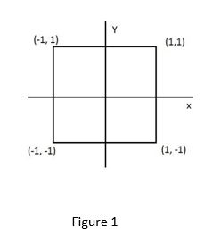
The figure 1 is first scaled up by a factor 2 and then translated by vector [2, 2]. What is the transformed figure?

Slide 18
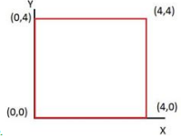
Sol:

Slide 19
Image Transform

Slide 20
What is Image Transforms ?
Transforming spatial domain pixels values to another domain using various existing transform methods, such as Fourier Transform, cosine transform, etc.
Why transforms are required?
Filtering (Fourier Transform)
Restoration (Fourier Transform)
Enhancement (Fourier Transform)
Compression (Cosine Transform)
Image analysis (KL Transform)

Slide 21
Available Transforms
Fourier transform For analysis of frequency spectrum in a image
Cosine transform For Compression of images
KL transform Used in compression, used as features and for image representation

Slide 22
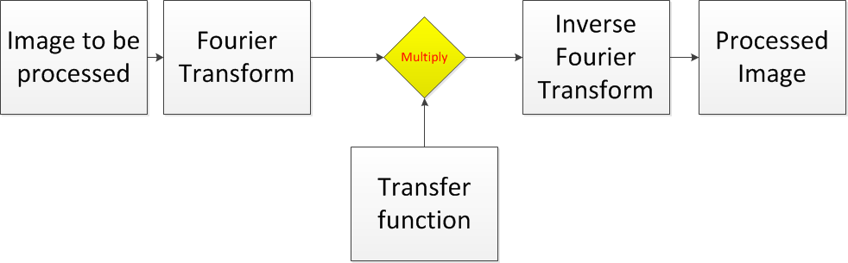
How transform is used in filtering

Slide 23
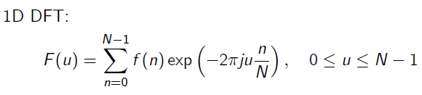
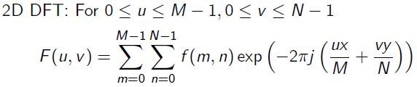
Discrete Fourier Transform
m
n

Slide 24
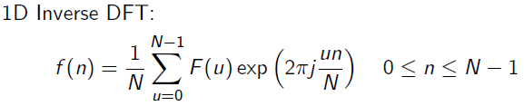
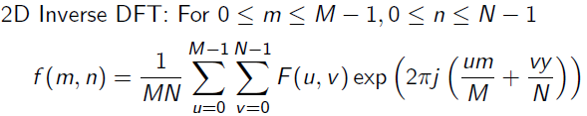
n

Slide 25
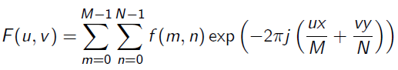
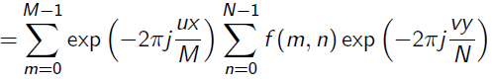
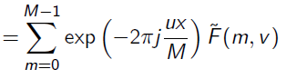
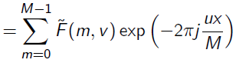
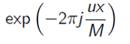
Separability property of Fourier Transform
x, y
x
y
x, y
x
y
1D DFT along row
x
x
1D DFT along column
x

Slide 26
Given a 2D Signal as follows (4x4)
Step-1 Perform 1D transform of all the rows in the above 2D signal we get the following
4 | 5 | 6 | 3
2 | 1 | 5 | 2
2 | 2 | 0 | 1
2 | 3 | 4 | 6
18 | -2-2j | 2 | -2+2j
10 | -3+1j | 4 | -3-1j
5 | 2-1j | -1 | 2+1j
15 | -2+3j | -3 | -2-3j
Step-2 Perform 1D transform of all the columns of this 2D signal we get the following
48 | -5+1j | 2 | -5-1j
13+5j | -6 | 3-7j | -2+2j
-2 | 5-7j | 0 | 5+7j
13-5j | -2-2j | 3+7j | -6

Slide 27
Translation property of 2D DFT
-
Multiplying f(x,y), by the exponential shifts the origin of the DFT to (u₀,v₀) and, conversely multiplying F(u,v) by the negative of that exponential shifts the origin of f(x,y) to (x₀,y₀)

Slide 28
Rotation Property
Using Polar Coordinates
This states that rotating f(x,y) by an angle θ₀ rotates F(u,v) by the same angle. Conversly, rotating F(u,v) rotates f(x,y) by the same angle.

Slide 29
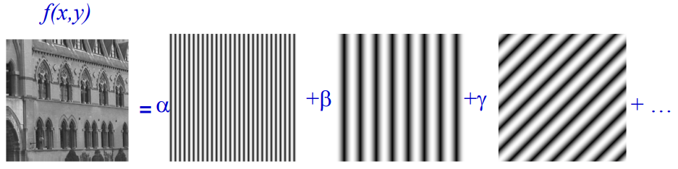

Slide 30



Slide 31
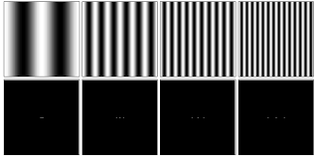

Slide 32
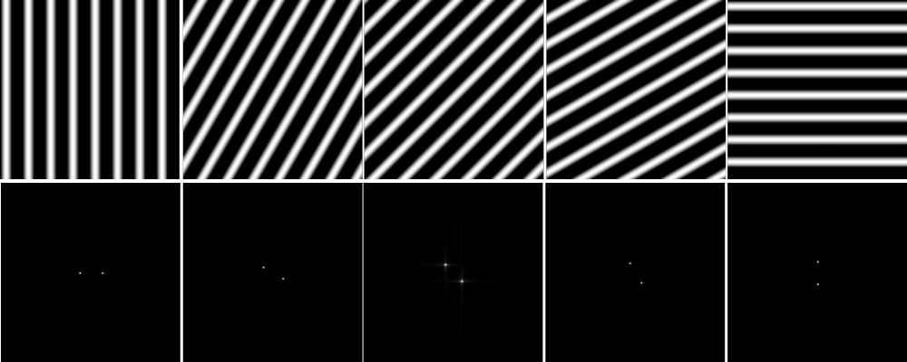

Slide 33
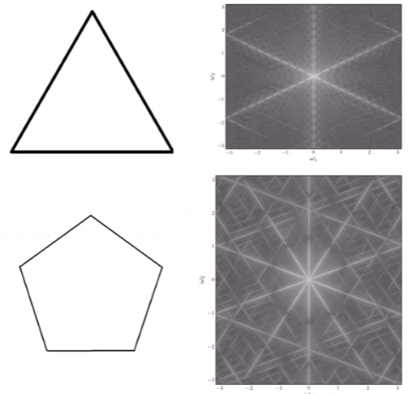

Slide 34
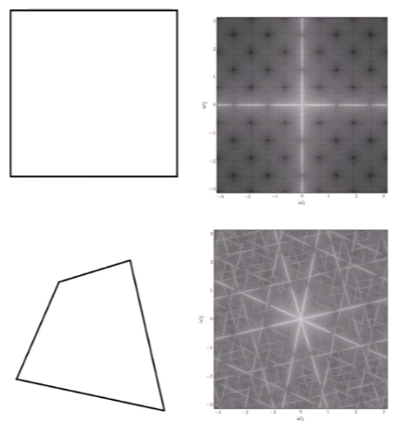

Slide 35
rotation
property

Slide 36
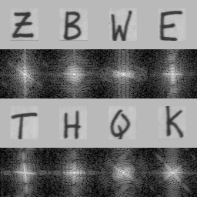
The FTs also tend to have bright lines that are perpendicular to lines in the original letter.
If the letter has circular segments, then so does the FT.

Slide 37
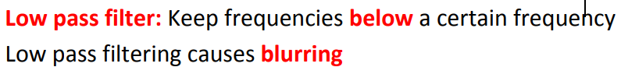
Filter design
LPF

Slide 38
The transfer function for the ideal low pass filter
D(u, v) → Euclidean distance from origin to Do,
Do → cut off freq.
H
h
w
Do
W inversely proportional to Do

Slide 39
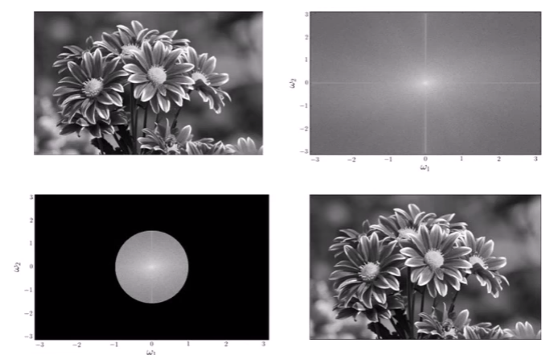
LPF

Slide 40
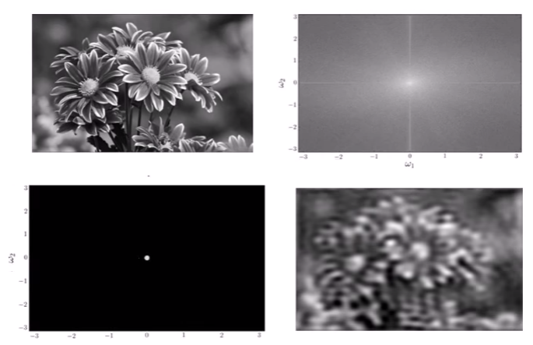

Slide 41
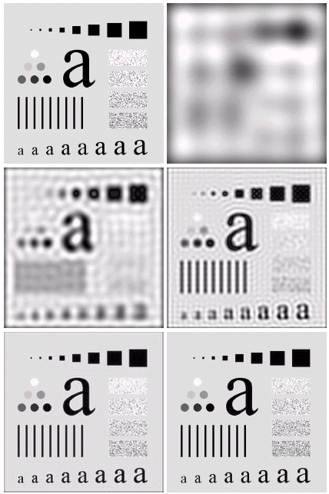
Result of filtering with ideal low pass filter of radius 5
Original image
Result of filtering with ideal low pass filter of radius 15
Result of filtering with ideal low pass filter of radius 30
Result of filtering with ideal low pass filter of radius 80
Result of filtering with ideal low pass filter of radius 230

Slide 42
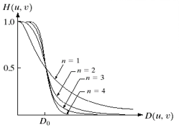
Butterworth Lowpass Filters
The transfer function of a Butterworth lowpass filter of order n with cutoff frequency at distance D₀ from the origin is defined as:
D(u, v) → Euclidean distance from origin to Do,
Do → cut off freq.

Slide 43
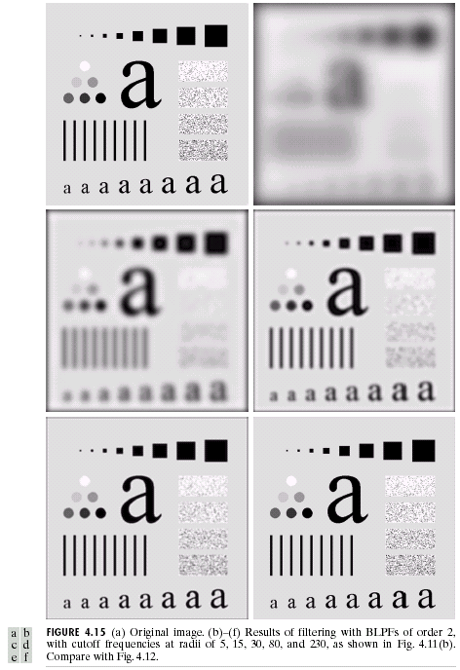
Result of filtering with Butterworth filter of order 2 and cutoff radius 5
Original image
Result of filtering with Butterworth filter of order 2 and cutoff radius 15
Result of filtering with Butterworth filter of order 2 and cutoff radius 30
Result of filtering with Butterworth filter of order 2 and cutoff radius 80
Result of filtering with Butterworth filter of order 2 and cutoff radius 230

Slide 44
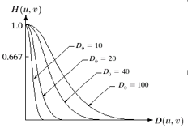
Gaussian Lowpass Filters
The transfer function of a Gaussian lowpass filter is defined as:

Slide 45
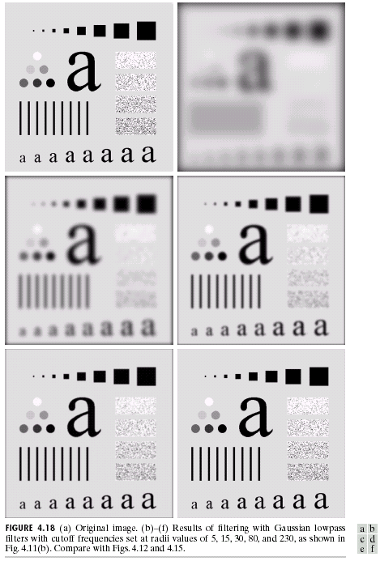
Result of filtering with Gaussian filter with cutoff radius 5
Original image
Result of filtering with Gaussian filter with cutoff radius 15
Result of filtering with Gaussian filter with cutoff radius 30
Result of filtering with Gaussian filter with cutoff radius 85
Result of filtering with Gaussian filter with cutoff radius 230

Slide 46

Lowpass Filters Compared
Result of filtering with ideal low pass filter of radius 15
Result of filtering with Butterworth filter of order 2 and cutoff radius 15
Result of filtering with Gaussian filter with cutoff radius 15

Slide 47
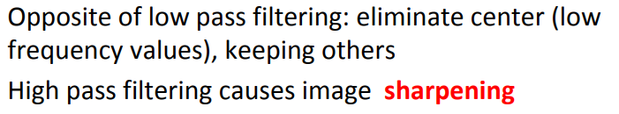

Slide 48
The transfer function for the ideal high pass filter

Slide 49
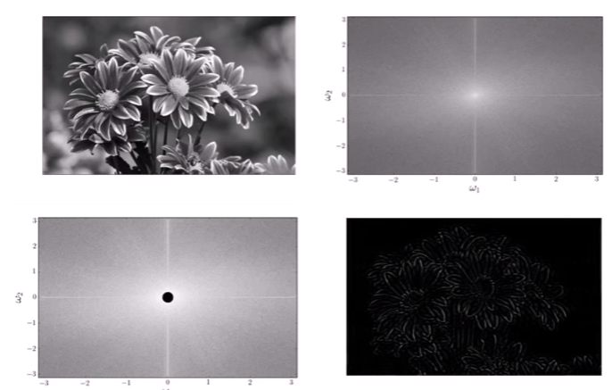
HPF

Slide 50
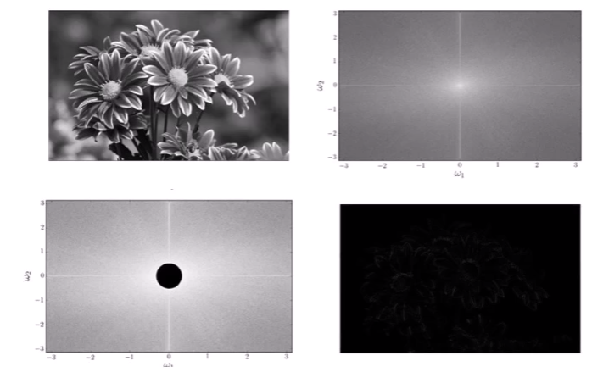

Slide 51
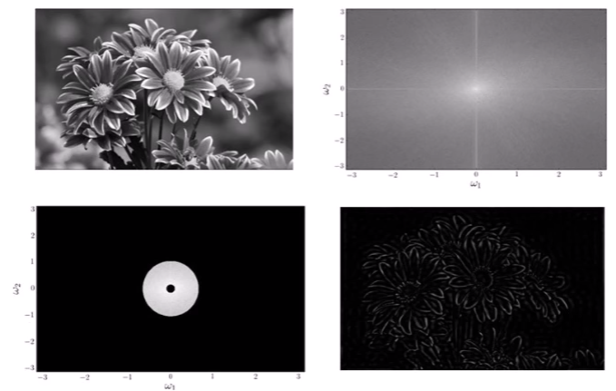
BPF

Slide 52
Butterworth high pass filter
The Butterworth high pass filter is given as:
where n is the order and D₀ is the cut off distance as before

Slide 53
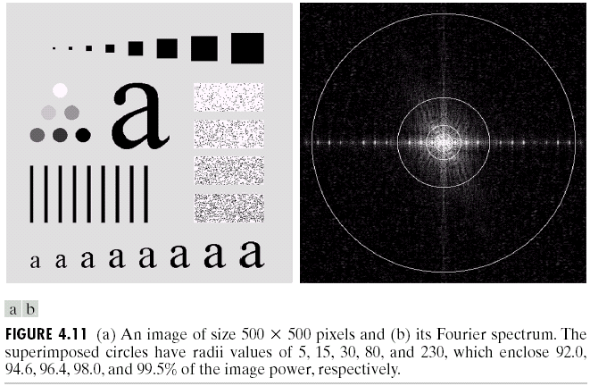
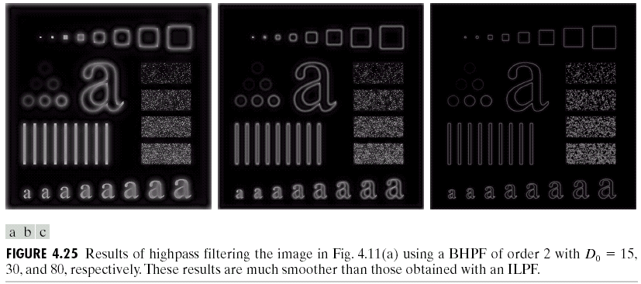
Results of Butterworth high pass filtering of order 2 with D₀ = 80
Results of Butterworth high pass filtering of order 2 with D₀ = 15
Results of Butterworth high pass filtering of order 2 with D₀ = 30

Slide 54
The Gaussian high pass filter is given as:
where D₀ is the cut off distance as before

Slide 55
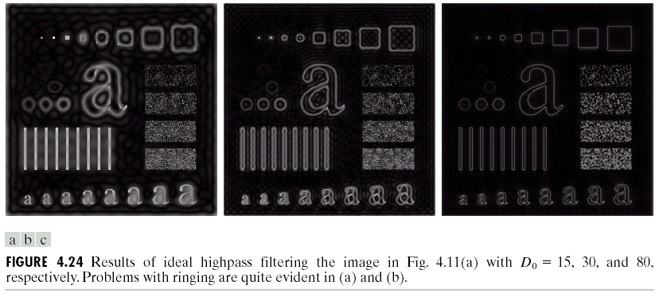
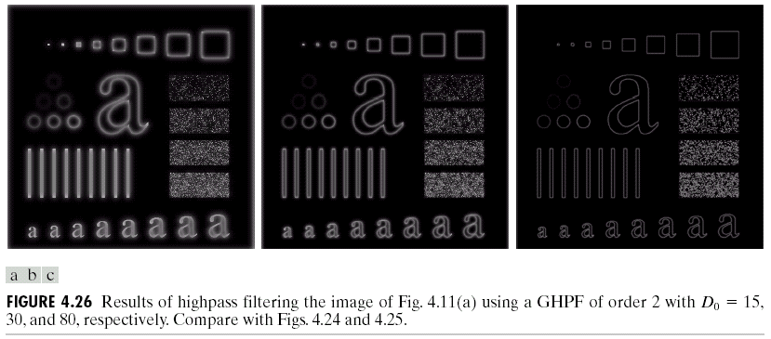
Results of ideal high pass filtering with D₀ = 15
Results of Butterworth high pass filtering of order 2 with D₀ = 15
Results of Gaussian high pass filtering with D₀ = 15

Slide 56
Results of ideal high pass filtering with D₀ = 15
Results of Butterworth high pass filtering of order 2 with D₀ = 15
Results of Gaussian high pass filtering with D₀ = 15

Slide 57
Discrete cosine transform
(Compression)

Slide 58

General transform equation

Slide 59
f (x, y)
g (x, y, u, v)

Slide 60

Discrete cosine transform

Slide 61

Notes:
Basis function

Slide 62


Slide 63

DCT and IDCT formula

Slide 64


100 X 100 image

Slide 65




Input image
Reconstructed image with coefficients=1
6
20

Slide 66
3 ways to apply basis function an image
One single basis function having dimension of the input image.
Dividing the image into K X K (non overlapping) and using basis function of that dimension in each block.
Dividing the image into K X K (overlapping) and using basis function of that dimension in each block.

Slide 67
X(0)
X(1)
X(2)
X(3)
1 | 1 | 1 | 1
1 | -j | -1 | j
1 | -1 | 1 | -1
1 | j | -1 | -j
4
5
6
3

